Slide 1

TITLE : Shopping Bill Generator
TEAM MEMBERS : RAJESH
PRAVEEN
PRAVEENA
SUVITHA
SRIDHAR
RADHA KRISHNAN

Slide 2
PROJECT OVERVIEW
OBJECTIVES
Calculate the total cost of purchased items based on their price and quantity.
Apply a discount (10%) on the total if the total amount exceeds 100.
Display a detailed bill showing the name, price, quantity, and total cost of each item.
Provide a final summary that includes the total price, discount percentage, and the final amount after the discount.
Ensure user interaction through input prompts for the number of items and their respective details (name, price, and quantity).

Slide 3
ADVANTAGES
Simplicity: The program is simple to use, even for users with limited technical knowledge.
Flexibility: The program can handle any number of items and is easily customizable to add new features.
Accuracy: It calculates the bill with accuracy by multiplying the price and quantity of each item.
Efficiency: The program uses minimal resources and runs quickly even with many items.

Slide 4

KEY FEATURES
Item Input:
The program takes input for multiple items, including their names, prices, and quantities.
Discount Calculation:
A discount of 10% is applied if the total bill exceeds 100.
Bill Calculation:
It calculates the total price of all items by multiplying the price of each item by its quantity.
The final total after applying the discount (if applicable) is also calculated.
Display of Bill:
A detailed bill is displayed with item names, prices, quantities, and the total cost for each item.
The total, discount, and final total after discount are displayed at the end.
User Interaction:
The user interacts with the program by entering the number of items, and details for each item.

Slide 5

CODE STRUCTURE
#include <stdio.h>
int main() {
int n;
float total = 0.0;
float discount = 0.0;
float finalTotal = 0.0;
printf("Enter the number of items: ");
scanf("%d", &n);
char itemNames[n][50];
float prices[n];
int quantities[n];
for (int i = 0; i < n; i++) {
printf("\nEnter the name of item %d: ", i + 1);
getchar();
scanf(“%[^\n]%*c”,itemNames[i]);
printf("Enter price of %s: ", itemNames[i]);
scanf("%f", &prices[i]);
printf("Enter quantity of %s: ", itemNames[i]);
scanf("%d", &quantities[i]);
total += prices[i] * quantities[i];
}

Slide 6
if (total > 100) {
discount = 10;
}
finalTotal = total - (total * discount / 100);
printf("\n==============================\n");
printf("Shopping Bill\n");
printf("==============================\n");
printf("Item Name\tPrice\tQuantity\tTotal\n");
for (int i = 0; i < n; i++) {
printf("%s\t%.2f\t%d\t\t%.2f\n", itemNames[i], prices[i], quantities[i], prices[i] * quantities[i]);
}
printf("==============================\n");
printf("Total: %.2f\n", total);
printf("Discount: %.2f%%\n", discount);
printf("Final Total: %.2f\n", finalTotal);
printf("==============================\n");
return 0;
}

Slide 7

PROGRAM FLOW
Initialization:
Declare necessary variables for item details, total price, discount, and final total.
Get the number of items from the user.
Input Data:
For each item, input the item name, price, and quantity.
Calculate the total cost for each item and accumulate it to the total.
Discount Check:
If the total price exceeds 100, a 10% discount is applied.
Final Calculation:
Compute the final total after applying the discount.
Display Bill:
Display each item's details (name, price, quantity, total cost).
Display the overall total, discount percentage, and final total after discount.
End of Program:
Program execution ends after displaying the final bill

Slide 8
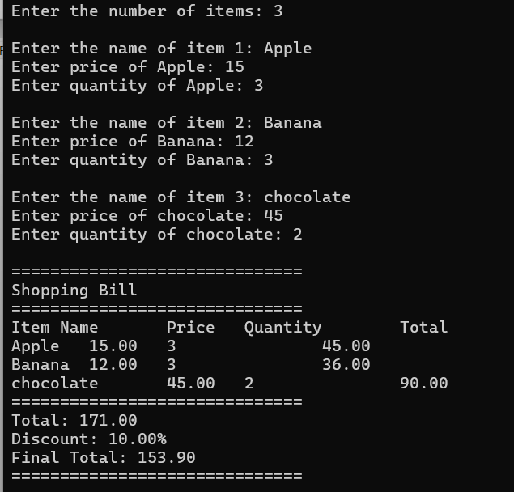
SAMPLE OUTPUT

Slide 9


